Slide 1
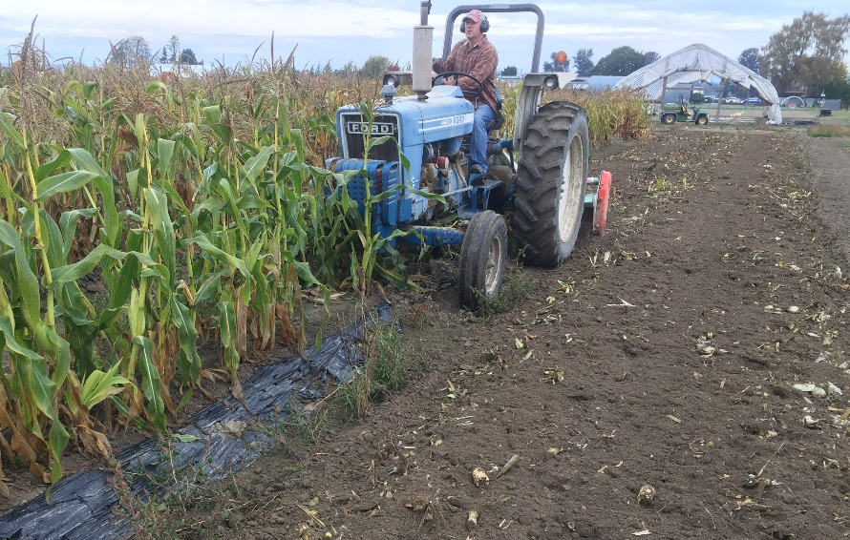




Soil-Biodegradable Plastic Mulch Professional Training
Soil Sampling For Visible Plastic Fragments Post Tillage
Carol Miles and Huan Zhang, Washington State University
Shuresh Ghimire, University of Connecticut
biodegradablemulch.org
https://smallfruits.wsu.edu
Notes:
This presentation provides information on methods and procedures for soil sampling for plastic fragments post-tillage.

Slide 2
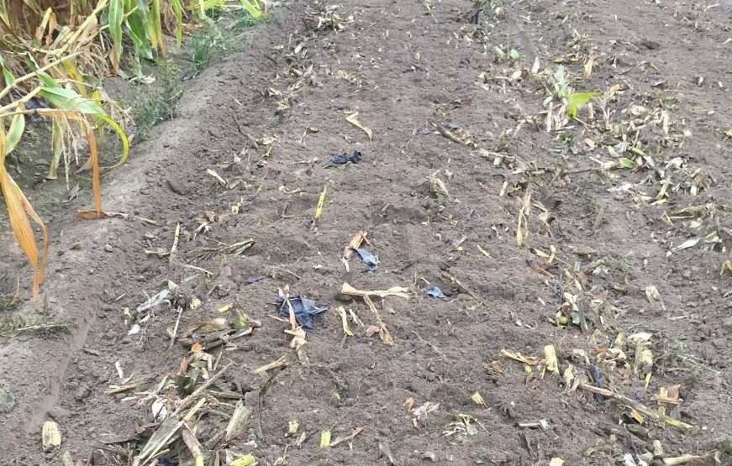
Measuring Visible Mulch
Why do we sample soil?
Presence of visible mulch fragments as a measure of initial stages of mulch degradation
Not a direct measure of rate or extent of biodegradation
If PE mulch in the soil, estimate
amount prior to BDM
Sampling procedure does not
distinguish between PE and BDM
plastic
Ghimire et al., 2020
biodegradablemulch.org
https://smallfruits.wsu.edu
Notes:
Soil sampling is used to measure visible mulch fragments and is a measure of initial degradation. It is not a direct measure of the rate or extent of biodegradation. If PE mulch is in the soil, it is necessary to estimate its amount prior to BDM application. This sampling procedure does not distinguish between polyethylene (PE) and BDM.

Slide 3
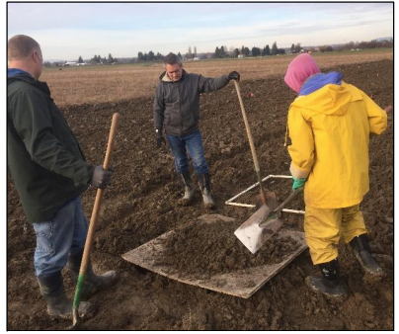
Collecting Soil Samples
Collect 5 random soil samples from each field
Use an X or Z pattern
Each sample 3 ft x 3 ft x depth ½ ft or to tillage depth
Place sample on plywood (≥ 4 ft × 4 ft)*
Ghimire et al., 2020
* This procedure works well for loam-type soils
biodegradablemulch.org
https://smallfruits.wsu.edu
Notes:
Collect 5 representative soil samples from the field you wish to sample using an X or Z pattern. Each sample area should be 3 ft x 3 ft to a depth of 1/2 foot or to tillage depth. Place the excavated soil on a piece of plywood (≥ 4 ft × 4 ft).

Slide 4
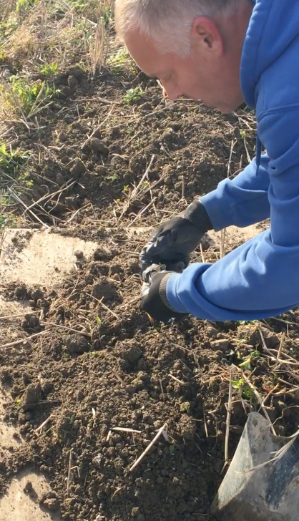
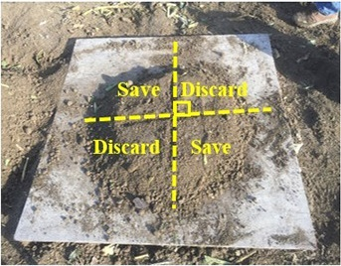
Quartering Method
Mix soil thoroughly
Spread soil out on plywood
Dividing a piece of mulch
If plastic fragment falls on multiple quarters, divide fragment and place pieces on respective quarters
Discard opposite quarters
Ghimire et al., 2020
biodegradablemulch.org
https://smallfruits.wsu.edu
Notes:
Mix the soil thoroughly and spread it out on the plywood. Reduce the amount of soil in the sample using the quartering method: divide the soil into quarters by creating two lines intersecting at right angles at the center of the pile (Fig. 1). If plastic fragments are found in multiple quarters, divide the fragments and place them on the respective quarters (Fig. 2). Discard two diagonally opposite quarters (Fig. 1).

Slide 5
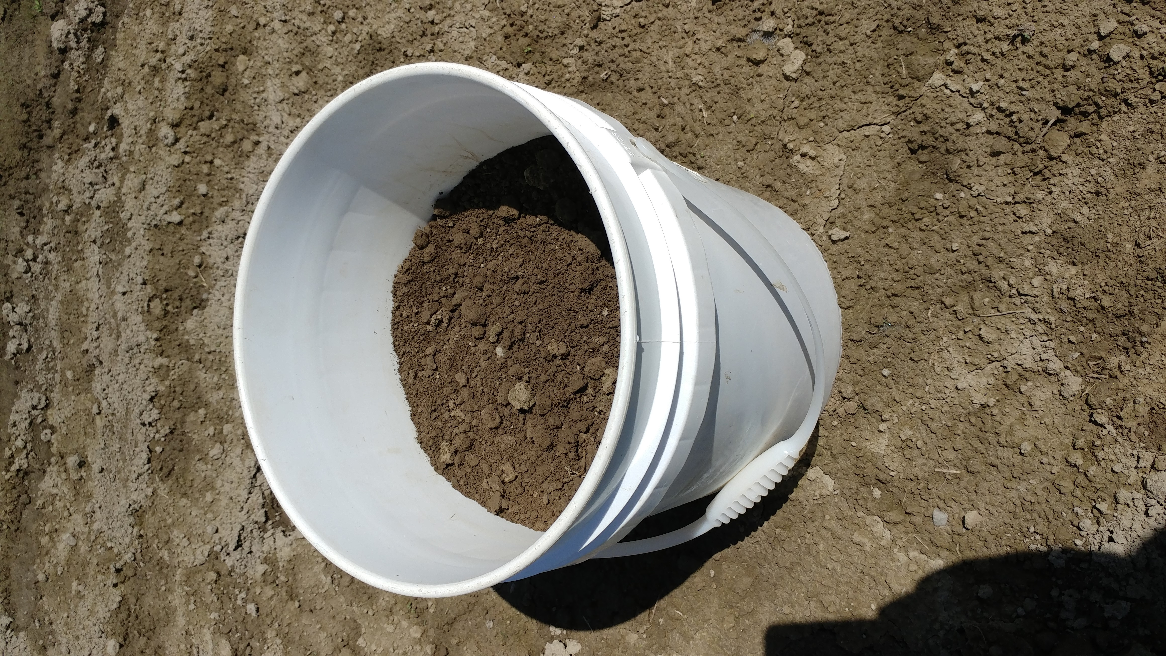
Collect Soil into Bucket
Remix 2 remaining quarters
Carry out quartering procedure for a total of 4 times
Final sample size approx. 2.5 gallons, 1/16 of original size
Ghimire et al., 2020
biodegradablemulch.org
https://smallfruits.wsu.edu
Notes:
Re-mix the sample and carry out this quartering procedure a total of four times, so that the final sample size is 1/16 of the original sample size, which is approximately 2.5 gallons.

Slide 6
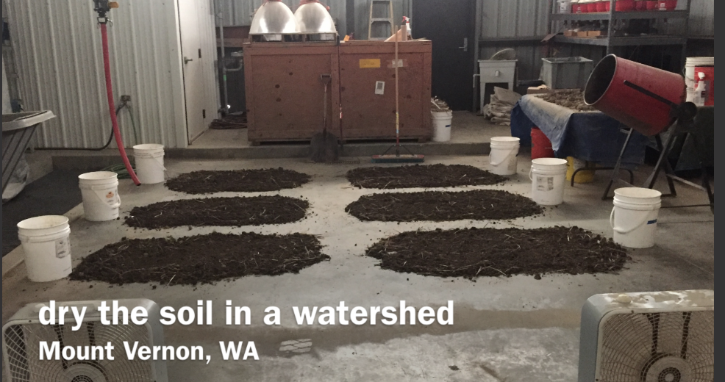
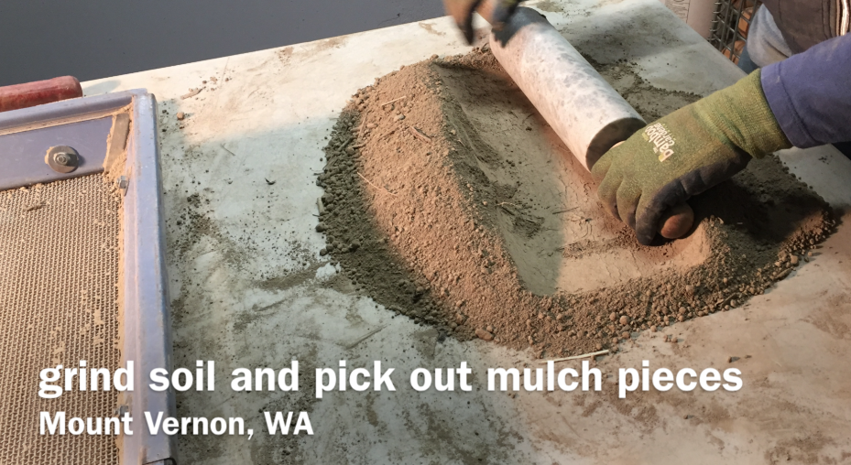
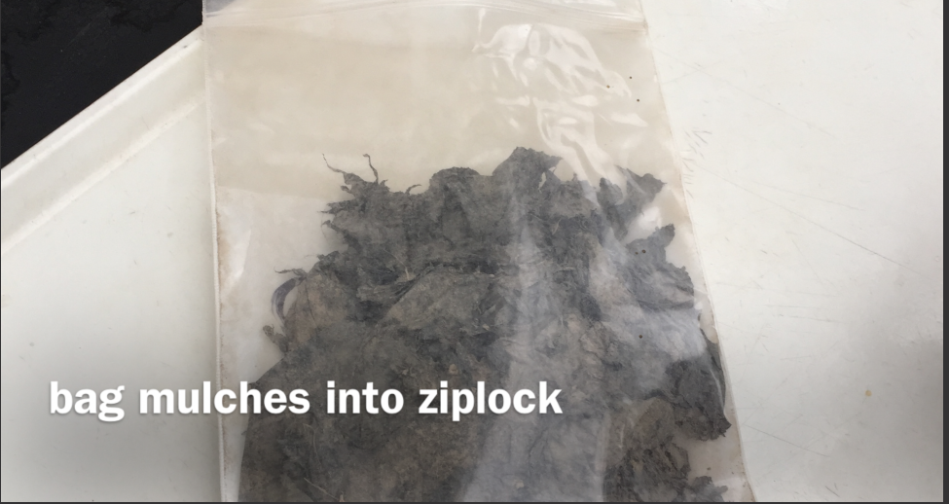
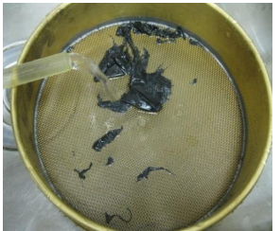
Removing Mulch from Soil
A
B
Dry soil
Grind soil
C
D
Rinse mulch using ASTM sieve no. 10 (2 mm)
Collect mulch in bag
Ghimire et al., 2020
biodegradablemulch.org
https://smallfruits.wsu.edu
Notes:
To recover mulch fragments from the soil sample, first dry the soil (Fig. 3A), then grind it with a heavy rolling pin (marble works well) (Fig. 3B). As you grind the soil, collect the plastic fragments and place them in a sealable plastic bag (Fig. 3C). Sieve the soil using the No. 8 sieve and place plastic fragments captured by the sieve into the bag. Place the plastic fragments in a large bowl or container (approx. 2 gal.), and rinse with tap water agitating gently by hand to remove any adhering soil. Pour the water out through the no. 10 sieve to capture the plastic pieces (Fig. 3D).

Slide 7
Calculating Mulch Amount
For each soil sample: air dry mulch fragments, record total weight of mulch fragments
Calculate the average weight of plastic per sample (total weight divided by number of samples)
Calculate the recovered mulch weight per acre using the equation below and Table 1. For example:
Weight of plastic recovered in each of 5 samples: 0.8, 1.2, 1.0, 1.1 and 0.9 g
Total plastic recovered from 5 samples = 5 g
Weight of mulch/acre = 5 x 15,488¹ = 77,440 g = 77.44 kg
¹See Table 1 for multiplication factor, which is based on number of samples
Ghimire et al., 2020
biodegradablemulch.org
https://smallfruits.wsu.edu
Notes:
Place the clean plastic fragments from each soil sample in a labeled paper bag and air dry. Record the total weight of the mulch fragments in each sample after air drying. This requires a precision balance that can read 1 mg to 100 g (Fig. 4). Calculate the average weight of plastic per sample by dividing total weight by number of samples. For example: The weight of plastic recovered in each of the 5 samples is 0.8, 1.2, 1.0, 1.1 and 0.9 g.

Slide 8
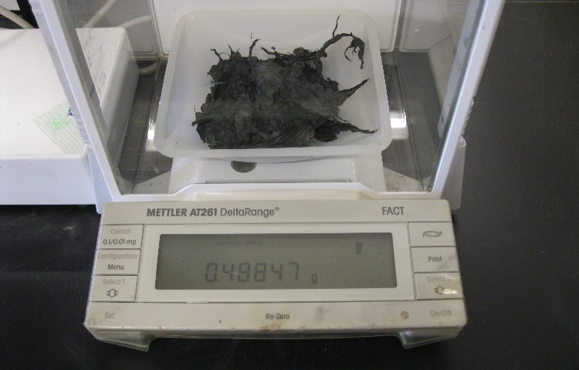
Calculating Mulch Amount
Table 1. Calculation of the weight of recovered mulch per acre based on 9 ft² per soil sample.
No. of samples | Sample collection total area (ft²) | Multiplication factor for weight of mulch/acre¹
3 | 27 | 25,813
5 | 45 | 15,488
6 | 54 | 12,907
7 | 63 | 11,063
8 | 72 | 9,680
9 | 81 | 8,604
10 | 90 | 7,744
11 | 99 | 7,040
12 | 108 | 6,453
Weighing plastic mulch fragments on a precision balance
¹Calculated by dividing the number of ft² per acre (43,560 ft²) by the total area sampled (each sample area is 9 ft²) and multiplying by 16 (measured sample was 1/16 of 3 ft x 3 ft sample)
Ghimire et al., 2020
biodegradablemulch.org
https://smallfruits.wsu.edu
Notes:
The multiplication factor for weight of mulch/acre is obtained by dividing the number of ft² per acre (43,560 ft²) by the total area sampled (each sample area is 9 ft²) and multiplying by 16 (measured sample was 1/16 of 3 ft x 3 ft sample).

Slide 9
Calculating Mulch Amount
Calculate the recovered area of mulch per acre from the average weight of mulch per acre using the equation:
Total area of mulch per acre = weight of mulch / (density of mulch x thickness of mulch)
Mulch density: BDM = 1.37 g/cm³ and PE mulch = 0.94 g/cm³
For mulch thickness of 1 mil (0.00254 cm)
Using our example, recovered mulch per acre = 77,440 g / (1.37 g/cm³ x 0.00254 cm)
= 22,254,152 cm² or 23,954 ft²
Ghimire et al., 2020
biodegradablemulch.org
https://smallfruits.wsu.edu
Notes:
Calculate the area of mulch from the weight of mulch using the following equation:
· Total area of mulch per acre = weight of mulch / (density of mulch x thickness of mulch)
· Mulch density: BDM = 1.37 g/cm³ and PE mulch = 0.94 g/cm³
· Assumption of thickness of mulch: 1 mil = 0.00254 cm
· Using the above example, recovered mulch per acre = 77,440 g / (1.37 g/cm³ x 0.00254 cm)
= 22,254,152 cm² or 23,954 ft²

Slide 10
Resources
Ghimire, S., M. Flury, E. Scheenstra, and C. Miles. 2019. Sampling and degradation of biodegradable plastic and paper mulches in field after tillage incorporation. Science of the Total Environment. https://doi.org/10.1016/j.scitotenv.2019.135577
Soil sampling method to assess the amount of plastic fragments in the field
https://s3.wp.wsu.edu/uploads/sites/2181/2020/07/Soil-sampling-factsheet.pdf
Video – Soil Sample Methods https://www.youtube.com/watch?v=o2TzGlZ6SCs&feature=youtu.be
biodegradablemulch.org
https://smallfruits.wsu.edu

