Slide 1
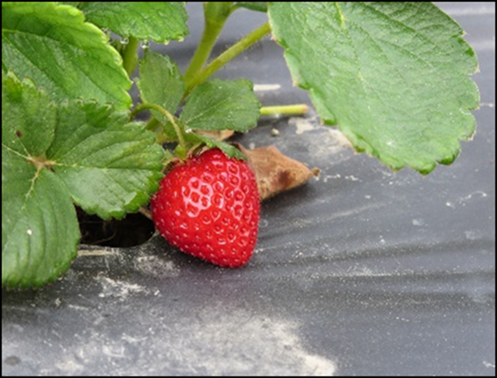




Soil-Biodegradable Plastic Mulch Professional Training
Sociology-Perceptions and Experiences with Soil-Biodegradable Mulch
Lisa DeVetter and Huan Zhang, Washington State University
Mark Bolda, University of California
https://smallfruits.wsu.edu
Notes:
This presentation provides information on perceptions and experiences of growers with soil-biodegradable mulch (BDM), and associated barriers and bridges for adoption.

Slide 2
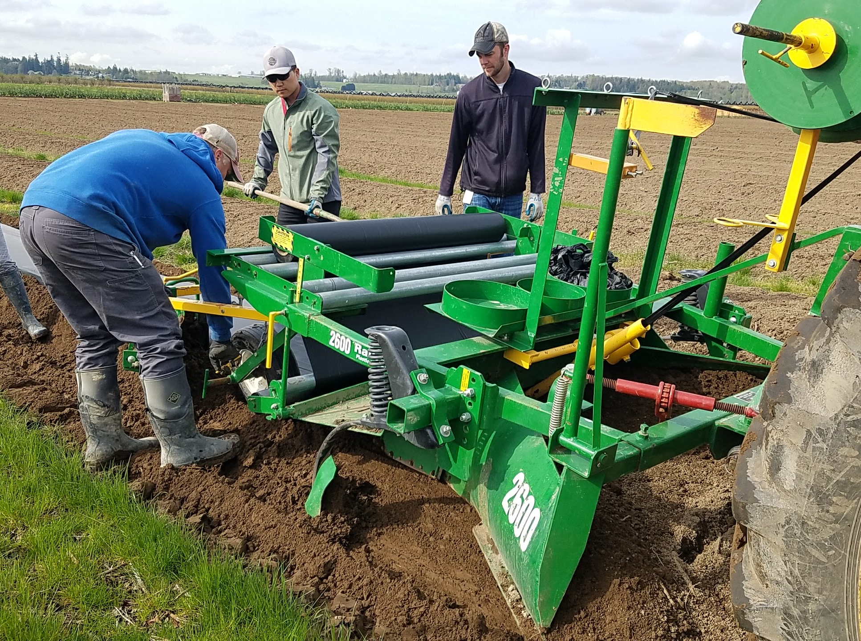
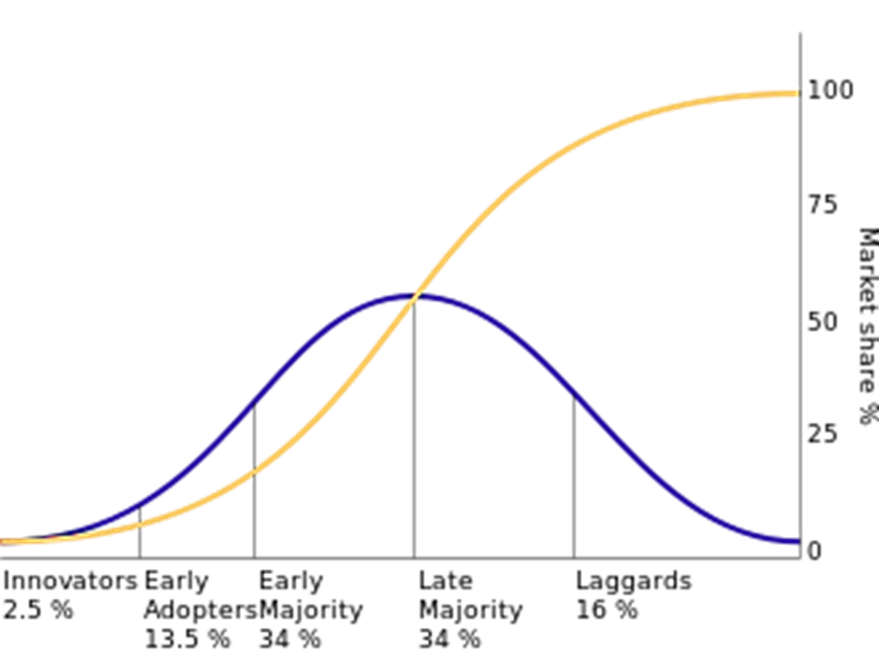
Sociology and BDMs
Sociology is the study of society, human behavior, and relationships
Sociology allows us to explore perceptions, experiences, and adoption of new technologies or innovations
BDMs are a new technology
https://smallfruits.wsu.edu
Notes:
Sociology is the study of society, human behavior, and relationships. It allows us to explore perceptions, experiences, and adoption of new technologies or innovations. BDMs are a new technology. There are five established adopter categories: innovators, early adopters, early majority, late majority, and laggards. The majority of the population tends to fall in the middle categories. People in the ‘early majority’ category need to see evidence of the innovation’s effectiveness while people in the ‘late majority’ category will only adopt an innovation after it has been tried by the majority.

Slide 3
Strawberry Surveys
Survey of 227 US strawberry growers in 2016 assessed growers’ perceptions and experiences with plastic mulches
52% of respondents agreed that BDMs are environmentally friendly
41% of respondents agreed that US strawberry growers are interested in using biodegradable plastic mulch films
State | Frequency | Percentage (%)
California | 32 | 14
New York | 41 | 18
Oregon | 30 | 13
Pennsylvania | 88 | 39
Tennessee | 8 | 4
Washington | 28 | 12
TOTAL | 227 | 100
Goldberger and Lyons, 2017
https://smallfruits.wsu.edu
Notes:
Goldberger and Lyons, in a survey of 227 US strawberry growers in 2016, assessed growers’ perceptions and experiences with plastic mulches. 52% of respondents agreed that BDMs are environmentally friendly. 48% agreed that BDMs can be laid with standard plastic mulch layers. 41% of respondents agreed that US strawberry growers are interested in using biodegradable plastic mulch films.

Slide 4

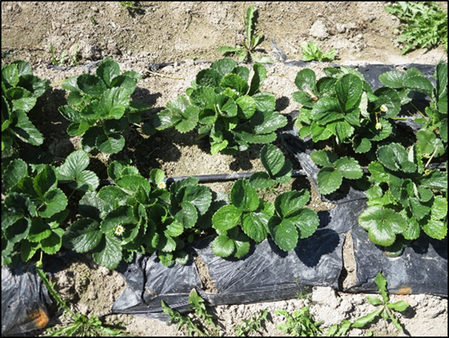

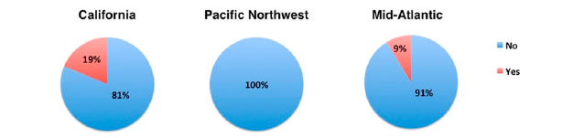
Strawberry Surveys
Have you ever used BDMs in your strawberry production?
Goldberger and Lyons, 2017
https://smallfruits.wsu.edu
Notes:
In their study, they asked growers if they have ever used BDMs in their strawberry production. Nearly one-fifth of California respondents, and 9% of Mid-Atlantic respondents had used BDMs in their strawberry fields while none of the respondents in Pacific Northwest had used BDMs in their strawberry fields.

Slide 5
Strawberry Surveys
Opinions about BDMs among strawberry growers surveyed in 2016
Pros* | Cons
No need to remove/dispose mulch (33%) | Breaks down too quickly (53%)
Healthy/clean plants (20%) | Degrades unevenly within fields or season-to-season (20%)
Weed control (13%) | Expensive (20%)
Biodegradability (13%)
Goldberger and Lyons, 2017
https://smallfruits.wsu.edu
Notes:
Respondents were asked about their opinions on BDMs in the survey. When asked what they liked most about using BDM in their strawberry fields, 33% of survey respondents mentioned the lack of need to remove/dispose of the mulch films, 20% mentioned about healthy/clean plants, 13% mentioned weed control, and 13% mentioned about biodegradability. Note that 33% of growers indicated they liked nothing about BDMs. When asked what they liked least, 53% of respondents mentioned that the mulch films break down too quickly, 20% mentioned thaBDMs degrade unevenly within fields or season-to-season, and 20% mentioned that BDMs are expensive.

Slide 6
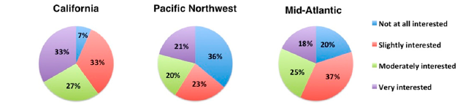
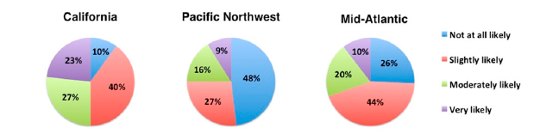
Strawberry Surveys
Are you interested in learning more about BDMs for US strawberry production?
How likely are you to use BDMs in your strawberry fields in the next 5 years?
Goldberger et al., 2019
https://smallfruits.wsu.edu
Notes:
When asked about their interest in learning more about BDMs for US strawberry production, a majority of respondents in all three regions expressed an interest in learning more about BDMs for strawberry production. A higher percentage of respondents in the Pacific Northwest (36%) and the Mid-Atlantic (20%) expressed no interest compared with California respondents (7%).
Nearly half (48%) of respondents in the Pacific Northwest were not at all likely to consider using BDMs in their strawberry fields in the next 5 years, compared with smaller percentages in California (10%) and the Mid-Atlantic (26%).

Slide 7

Survey of CA Strawberry Growers
Online Qualtrics^{XM} survey led by Goldberger and DeVetter with assistance from Gomez and Bolda
Surveyed 6 counties in CA
N = 43 respondents - 24% of the strawberry acreage in 2018*
Owners, partners, lessees, or hired managers
Farm size range was 0 to 463 ha, averaged 81 ha
* USDA NASS, 2019
https://smallfruits.wsu.edu

Slide 8
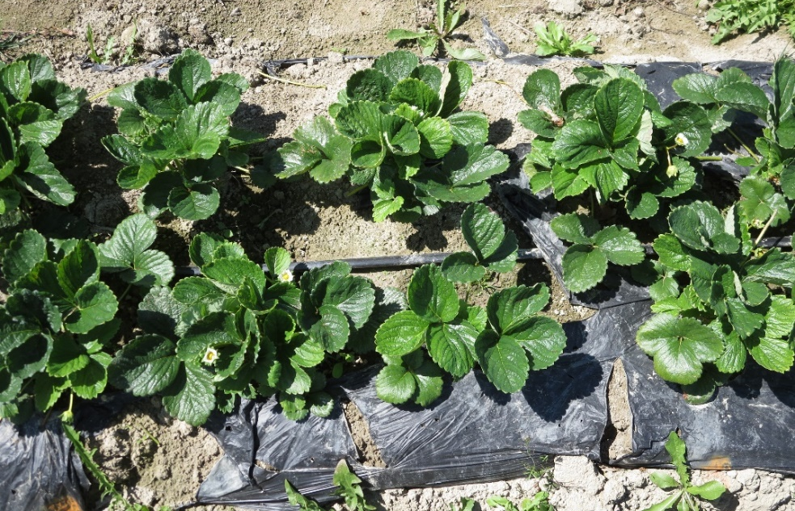
Results of CA Strawberry Survey
5% and 10% used BDMs in all or some of their fields, respectively
Only one grower was satisfied with BDM performance
77% reported BDMs appear to be an unproven technology
Concerns about BDM:
Durability
Degrading before the next crop rotation
Compatibility with soil fumigation
Cost
Color
Likelihood of using BDMs in the future [percentages, rounded (%)]
Not at all | Slightly | Moderately | Very
40 | 35 | 15 | 10
https://smallfruits.wsu.edu

Slide 9
Barriers and Bridges to Adoption
Surveys and focus groups conducted between 2008-2012 with growers, extension agents, agriculture input suppliers, mulch manufacturers, and other stakeholders
Barriers | Bridges
Insufficient knowledge | Reduced waste
High cost | Environmental benefits
Unpredicted breakdown | Interest in additional knowledge
Goldberger et al., 2013
https://smallfruits.wsu.edu
Notes:
Barriers and bridges to adoption were explored in surveys and focus groups conducted between 2009 and 2012 with growers, extension agents, agriculture input suppliers, mulch manufacturers, and other stakeholders. Barriers of adoption were found to be 1) insufficient knowledge; 2) high cost, and unpredicted breakdown of BDM. Bridges to adoption were noted to be 1) reduced waste; 2) environmental benefits; and 3) interest in additional knowledge of growers.

Slide 10
Measuring Experiences and Opinions
On-farm trials with watermelon, winter squash, and cut flowers
Achieved good crop quality and yield with BDMs
BDMs visibly degraded
Plastic BDMs preferred over PE and paper mulch and considered more environmentally friendly
Growers concerned about:
Aesthetics of plastic BDMs (which look like PE mulch)
Soil health over time
Customers may have negative connotations with the word “plastic” even if it’s biodegradable
Image: D. Low, 2014
Dentzman and Goldberger, 2018 and 2019
https://smallfruits.wsu.edu
Notes:
On-farm trials with watermelon, winter squash, and cut flowers achieved good crop quality and yield with BDMs. BDMs visibly degraded. Farm owner and operators, who were concerned about BDM fragments looking like non-biodegradable plastic when tilled down in the fall, were pleased with how the BDMs had broken down in the following spring. They found few scraps remaining in the soil. Plastic BDMs were preferred over PE and paper mulch, and were considered more environmentally friendly. Growers were concerned about aesthetics of plastic BDMs (which look like PE mulch), soil health over time, and fear that customers may have negative connotations to the word “plastic” even if it’s biodegradable.

Slide 11
Resources
Barriers and Bridges to the Adoption of Biodegradable Plastic Mulches for US Specialty Crop Production
https://pdfs.semanticscholar.org/a05a/6b56fd0eb8ad3d162ef1587cf3b33acf6ea1.pdf
On-Farm Biodegradable Mulch Case Studies
Winter squash - https://ag.tennessee.edu/biodegradablemulch/Documents/CaseStudyFactsheet-Omache-9-14-18FINAL.pdf
Watermelon - https://ag.tennessee.edu/biodegradablemulch/Documents/CaseStudyFactsheet-Cloudview-9-14- 18FINAL.pdf
Cut flowers - https://ag.tennessee.edu/biodegradablemulch/Documents/CaseStudy-Boxx%20Berry.pdf
Polyethylene and Biodegradable Plastic Mulches for Strawberry Production in the United States: Experiences and Opinions of Growers in Three Regions –
https://doi.org/10.21273/HORTTECH04393-19
Use of Plastic Mulch Films in US Strawberry Production
https://ag.tennessee.edu/biodegradablemulch/Documents/Strawberry_Grower_Survey_Summary_Report-February2017.pdf
What Is the Technology Adoption Working Group and Why Is It Necessary?
https://ag.tennessee.edu/biodegradablemulch/Documents/Fact-sheet-TAWG-FINAL.pdf
https://smallfruits.wsu.edu

