Slide 1

2018 WSEC R: using the C3 calculator
2018 WSEC-R:
Using the C3 Calculator
WSU Code Compliance Calculator
Carolyn Roos, Ph.D., Energy Engineer
WSU Energy Program
Updated July 6, 2022
Notes:
For PPT to take up one screen – On slide show ribbon, select “Set Up Slide Show”. Set “Slide Show Monitor” to primary.

Slide 2
Using the Code Compliance Calculator
Outline
Purpose/background
Orientation
  Opening a new file
  Color scheme for cells and tabs
Preliminaries: Setting up your Analysis
Entering Your Design Details
Examples:
  Single Family Home
  Small Addition with trade off analysis

Slide 3
Purpose and Background
Documents code qualification of building designs by:
    UA percent reduction for Option 1 envelope measures (R406.3)
        (Options 1.3 to 1.6 for 2018, Options 1a to 1c for 2015)
    Total UA Alternative (component performance) (R402.1.4)
    UA trade offs of additions with existing home (R502.1.1.1)
Includes both WSEC 2015 and WSEC 2018
Integrates other WSU spreadsheets into one
    Glazing schedule, heating system sizing & UA trade off analysis
C3 requires MS Excel for Windows
  Installed on your computer, not web-based Excel

Slide 4
Want to Use the Prescriptive Pathway?
The C3 does not implement the prescriptive path (Section R402.1.1)
For the prescriptive path, email jonathan.p.jones@wsu.edu

Slide 5


Getting Started
Download "Code Compliance Calculator" off our website: http://www.energy.wsu.edu/BuildingEfficiency/EnergyCode.aspx
Macro-Enabled Spreadsheet
Before tabs will open, you must first
    Enable Macros
    Then accept terms of use
The first time you use the tool, it will open to a screen that provides tips in case you are having difficulty. For e.g.
    Your anti-virus is blocking macro-enabled spreadsheets
    You aren’t using compatible spreadsheet software
You will only see this the first time you use a particular version

Slide 6

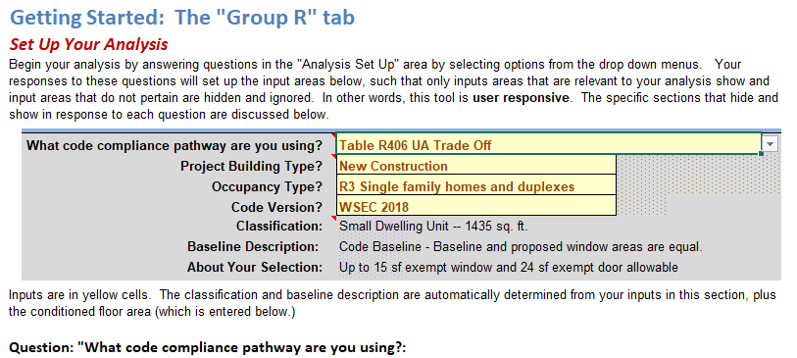
Getting Started Tab
Provides background and instructions on using the tool
Screenshots of each section of the “Group R” tab with background and example inputs
Button at top takes you to Group R tab

Slide 7
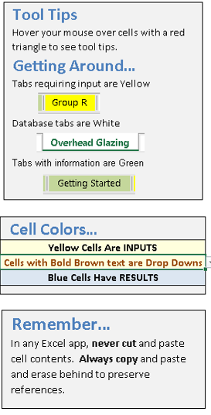
Tool Tips
Tabs
    Yellow: Inputs
    White: Databases of U-values
    Green: Informational Sheets
Cells
    Input cells are Yellow
    Yellow cells with bold brown text are drop downs
    Gray & blue cells have calculations & results
      – normally protected, do not edit
Important:
    Never cut and paste. Only copy and paste.
    Save a back up of the master file and when you start a new analysis, save it to a new name

Slide 8

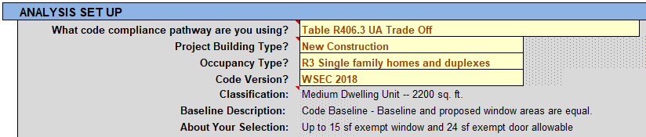
Setting Up Your Analysis
Your responses in this section set up the spreadsheet
    Automatically hides irrelevant areas and shows relevant areas
    Sets defaults & requirements for your analysis selections
Classification, Baseline description, About your selection
    These cells provide feedback on your selections
Remember:
    Inputs are yellow
    Gray areas are calculations – do not edit

Slide 9

Setting Up Your Analysis:
What Compliance Pathway Are You Using?
Four options on drop down menu
  Table R406 UA Trade Off
  User-Defined Baseline – for Addition or Remodel/Alteration
      Opens a second input area to the right to define baseline
  Total UA Alternative
  Complete Tables 406.2 and 406.3 Only
      All input areas close except those necessary to complete these tables.

Slide 10

Setting Up Your Analysis:
Project Building Type?
Three options on drop down menu:
  New Construction
  Addition
    Select "Table 406 UA Trade Off" as compliance pathway if you will not make any alterations to existing home
    Select "User-Defined Baseline" to do UA trade off analysis accounting for alterations to existing home, per Section R502.1.1.1
  Remodel/Alteration
    Must use "User-Defined Baseline" as compliance pathway
    Use this option to determine if the alteration or repair uses "no more energy than the existing building or structure prior to the alteration or repair", per Section R503.1

Slide 11

Setting Up Your Analysis:
Occupancy Type?
Two options on drop down menu:
  R2 Multifamily
  R3 Single Family Homes and Duplexes
Occupancy is used with permitted floor area and code version to determine energy credits required

Slide 12

Setting Up Your Analysis:
Code Version?
What code version are you permitted under?
  WSEC 2015
  WSEC 2018
Shows fuel normalization credit selection for WSEC 2018
Modifies energy credit options and values accordingly

Slide 13
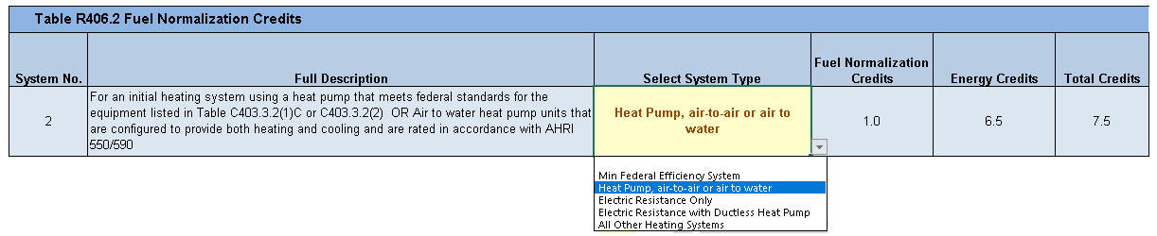
Additional Energy Efficiency Requirements
Fuel Normalization Credits, WSEC 2018
Select your System Type from the drop down
    1. Minimum Federal Efficiency System
    2. Heat Pump, air-to-air or air-to-water
    3. Electric Resistance Only
    4. Electric Resistance with Ductless Heat Pump
    5. All Other Heating Systems

Slide 14
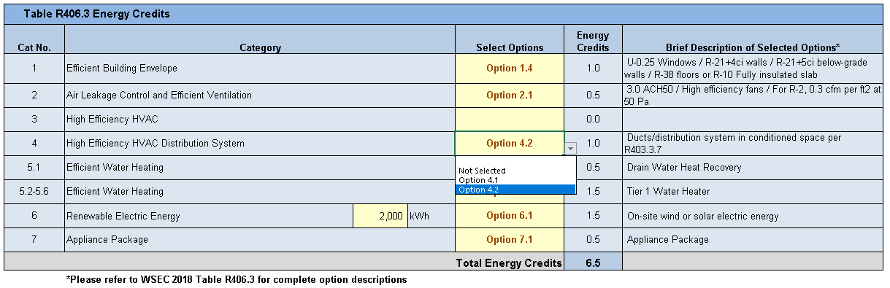
Additional Energy Efficiency Requirements
Energy Credits
A drop down for each category of options ensures you can only choose one of each:
  Except Option 5 Efficient Water Heating has two drop downs because Option 5.1 (or Option 5a) can be taken with other Option 5’s.

Slide 15
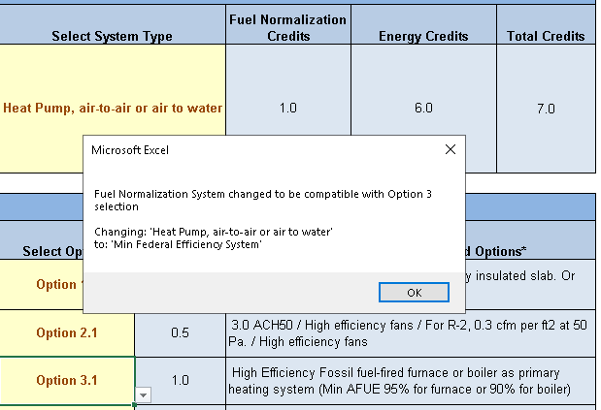
Additional Energy Efficiency Requirements
Energy Credits 1
If you select an Option 3 HVAC system that is not compatible with your Fuel Normalization System Type
  A pop-up informs you that your System Type is being changed to be compatible

Slide 16
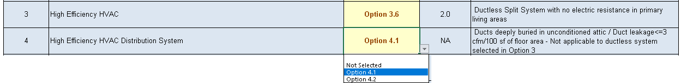
Additional Energy Efficiency Requirements
Energy Credits 2
Option 4 credits cannot be used with ductless systems
  Credit is “NA” if you select an Option 4 with Option 3.4 or 3.6
Option 6: For Renewable Electric Energy, also enter the annual electrical generation per housing unit in kWh
  Determine kWh from NREL’s PVWatts calculator or approved alternate
  Energy credits are calculated as 1 credit per 1200 kWh up to maximum of 3 credits

Slide 17
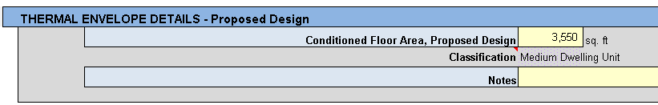
Thermal Envelope Details
Conditioned Floor Area
Enter your conditioned floor area
If you entered “User-Defined Baseline”, there is an identical input to the right for the baseline → Scroll to the right to see it fully
The Classification is automatically determined by the floor area together with your previous entry for Project Type
Suggestion: For User-Defined Baselines, use the optional note area to describe the differences between your baseline and proposed designs

Slide 18
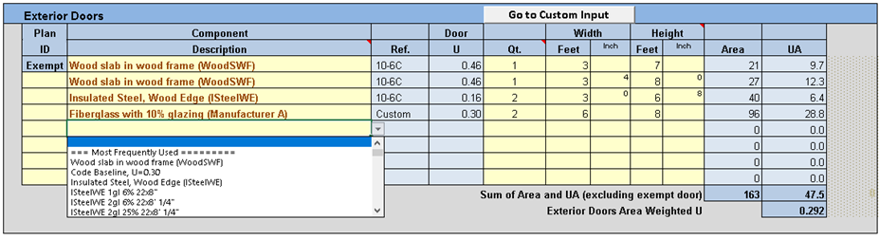
Thermal Envelope Details
Exterior Doors
Select the description of up to seven exterior doors from the drop down menus
For doors, these drop downs correspond entries in Table R303.1.3(2) “Default Opaque Door U-Factors”
For Prescriptive Path, exempt area shows for up to 24 sf in rough opening area
Component Description menus include a “Most Frequently Used” section
  Most frequently used doors include: Wood slab, Code Baseline U=0.30, and doors from the database with U-factors equal to or less than the code baseline

Slide 19

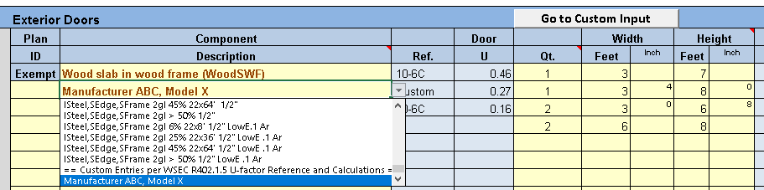
Thermal Envelope Details
Exterior Doors - Entering Custom U-value
If you have data for doors you will be installing, enter a custom description and U-value in the database
  Use the “Go to Custom Input” button to jump to door database
  Your entry in the database will automatically appear at the bottom of the drop down menu
  Any “Custom” selections automatically generate a message in red to the right
    This is just a flag for reviewer and a notice to users to provide documentation of their U-value to the AHJ. It is not an error message, just an alert

Slide 20


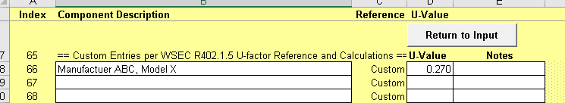
Thermal Envelope Details
Doors Database- Entering Custom U-value
The “Go to Custom Input” button jumps you right to the custom input area of the corresponding databases.
In the white cells:
  Enter a unique description and U-value
  Enter optional notes about your selection
Use the “Return to Input” button to return to the Group R tab
  Find your new entry at the bottom of the door drop down
Tip: This is similar for all databases

Slide 21
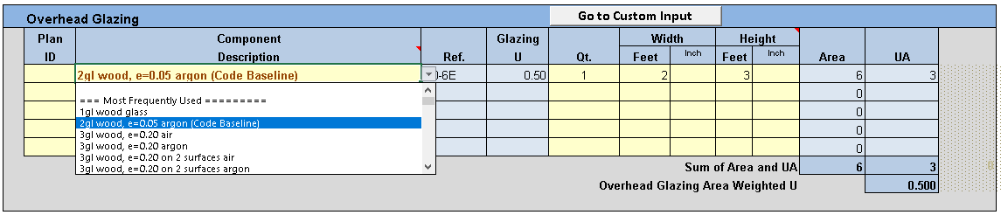
Thermal Envelope Details
Overhead Glazing
Enter up to five skylights
  Enter quantity and width and height of rough opening
  Enter optional Plan ID
Descriptions on the drop down correspond to tables in Section R303
As with doors if you have product data, use “Go to Custom Input” button to jump to the custom area of the “Overhead Glazing” database

Slide 22

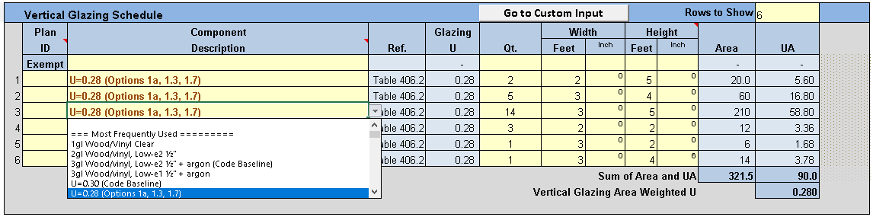
Thermal Envelope Details
Vertical Glazing
Enter up to 60 types of vertical glazing
Yes, 60 – But you can enter a “Rows to Show” to hide unused rows
  Any leftover data in hidden rows is automatically ignored
Most drop down descriptions correspond to Tables in Section R303
As with doors, for Prescriptive Path an input opens for up to 15 sf of rough opening area for exempt ornamental window.
  Total area, UA-value and area-weighted U-value do not include exempt window
  Exempt window is included in heating system sizing section, however.

Slide 23
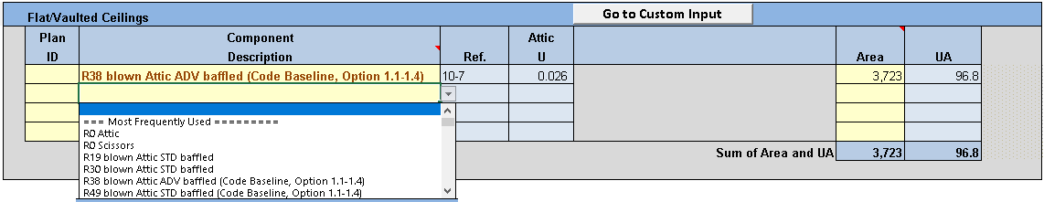
Thermal Envelope Details
Flat/Vaulted Ceilings
Enter up to four types of flat or vaulted ceilings
Drop down selections are based primarily on constructions found in Appendix A
As before, use “Go to Custom Input” to enter custom constructions
  Custom U-values should be calculated in accordance with WSEC Appendix A and R402.1.5
  Submit your calculations to the AHJ for review

Slide 24
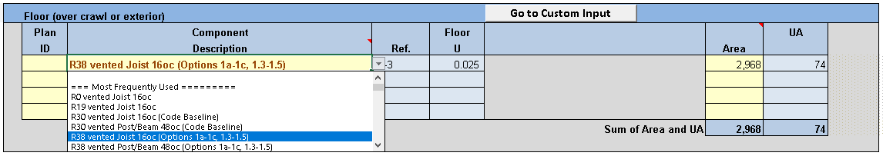
Thermal Envelope Details
Above-Grade Walls, Floors, & Above-Grade Slabs
Input for above-grade walls and floors is similar to input for ceilings
Input for above-grade slabs (less than 2’ below grade) is also similar, except the exterior perimeter is entered instead of area
Above-grade walls includes both exterior walls and walls separating conditioned space from an unconditioned space
  Same for floors over an unconditioned garage or basement
  Similarly, perimeter of above-grade slab along a garage wall is entered

Slide 25

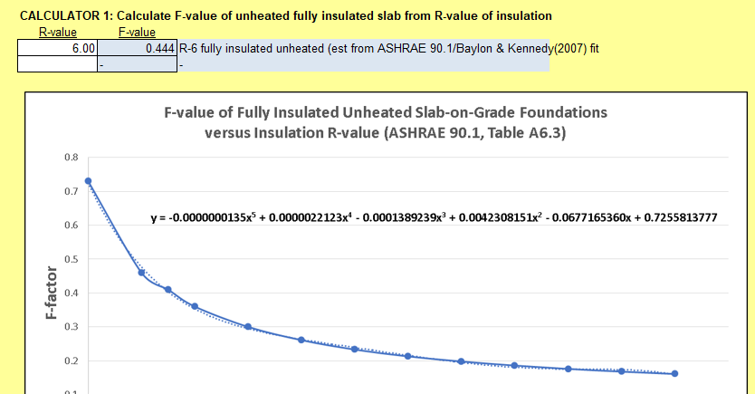
Calculator 1
Fully Insulated Unheated Above-Grade Slabs
Side calculator on the “Slab on Grade” database tab
Enter the overall R-value of insulation in white.
F-value is estimated based on curve fit of ASHRAE 90.1, Table A6.3

Slide 26
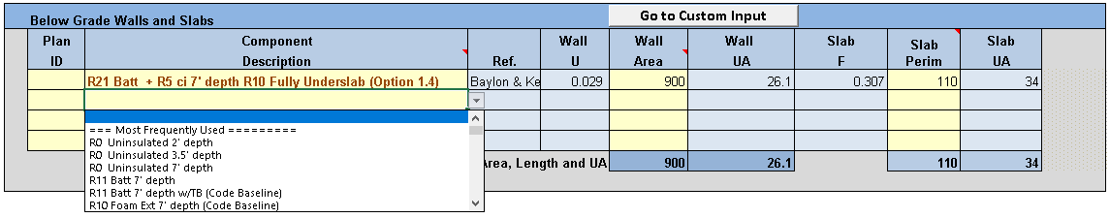
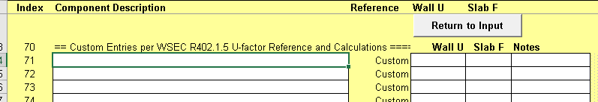
Thermal Envelope Details
Below-Grade Slabs
Below-grade slabs are 2 feet or more below grade
Require input of both the wall area and the slab perimeter
Associated database requires description, wall U-value & slab F-value

Slide 27
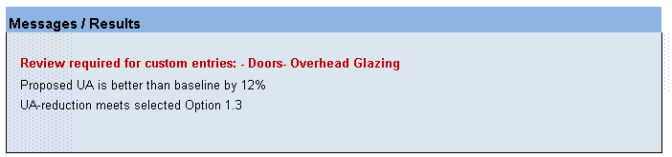
Results / Messages
Results are at top of Group R tab in two areas
Message area provides:
  Statements of results, such has how Proposed UA compares to baseline and if the UA-reduction meets the selected Option 1
  Alerts that custom entries require review
    Provide documentation to AHJ
    These are not error messages unless they include the word “Error”.
  Warnings if there are errors in the analysis

Slide 28
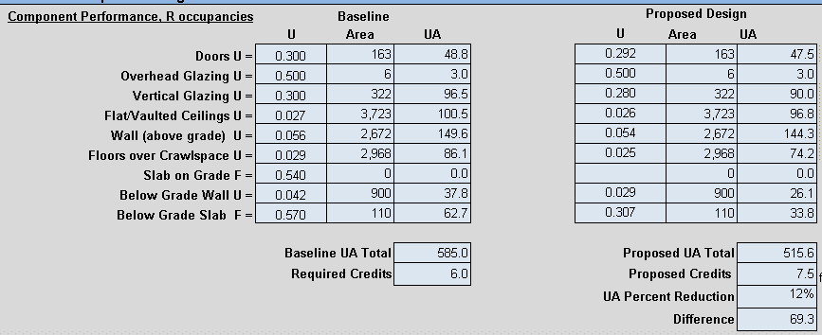
Results / Messages 2
Numerical summary of U-values, Areas and UA-values for Baseline and Proposed Design
Provides required credits and proposed credits selected from Tables 406.2 and 3
Provides UA reduction of proposed design compared to baseline

Slide 29
Other Calculation Areas
Ventilation Requirements
HVAC Thermal Distribution System
Heating System Sizing

Slide 30
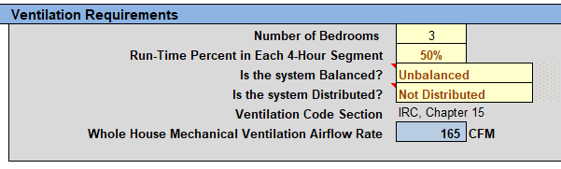
Ventilation Requirements
Whole House Ventilation Airflow Rate
Calculates required airflow rate
  Per IRC Chapter 5 for R3 and IMC Section 403 for R2
  Based on conditioned floor area, bedrooms, run-time and characteristics of the system

Slide 31
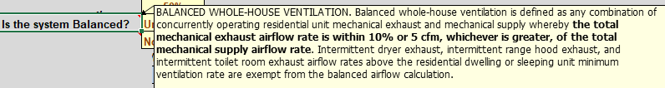
Ventilation Requirements
Whole House Ventilation Airflow Rate 2
Balanced:
  System with exhaust and supply fans, excluding intermittent exhaust fans
  Exhaust and supply airflow rates within 10%
  See the comment on the cell for definition

Slide 32

Ventilation Requirements
Whole House Ventilation Airflow Rate 3
Distributed
  Supplies ventilation air directly to each dwelling or sleeping unit habitable space
    including living room, den, office, interior adjoining spaces and bedrooms
  Exhausts air from all kitchens and bathrooms directly outside
  See the comment on the cell for definition

Slide 33
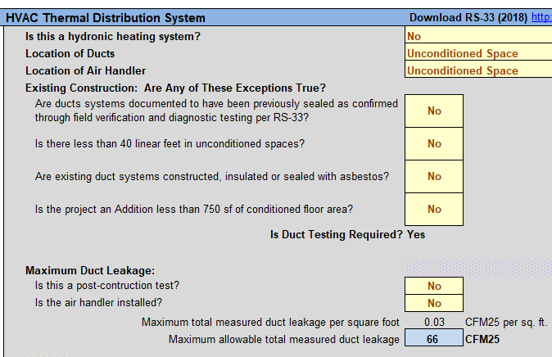
HVAC Thermal Distribution System
Duct Testing Requirements
Per RS=33, determines
  If duct testing is required
  Maximum allowable measured duct leakage

Slide 34
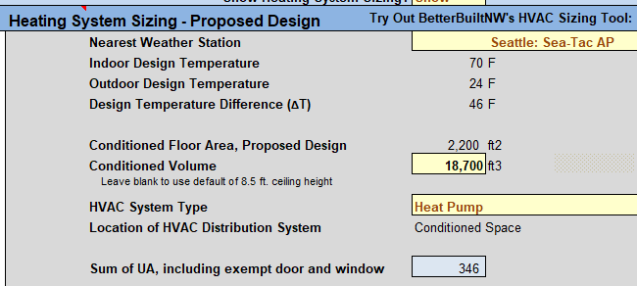
Heating System Sizing Worksheet
Provides a preliminary estimate of the heating system size.
  Single zone,
  Sizes heating systems only
  Will not accurately size cooling systems.
Placeholder submitting permit documents before an HVAC contractor provides a more accurate zonal heating-cooling calculation
Consider using ACCA Manual J and S or NEEA's SpecPro, as approved by AHJ per R403.7 "Equipment Sizing and Efficiency Rating".
  ACCA Manual J and S, https://www.acca.org/home
  NEEA's SpecPro, https://betterbuiltnw.com/resources/hvac-sizing-tool

Slide 35
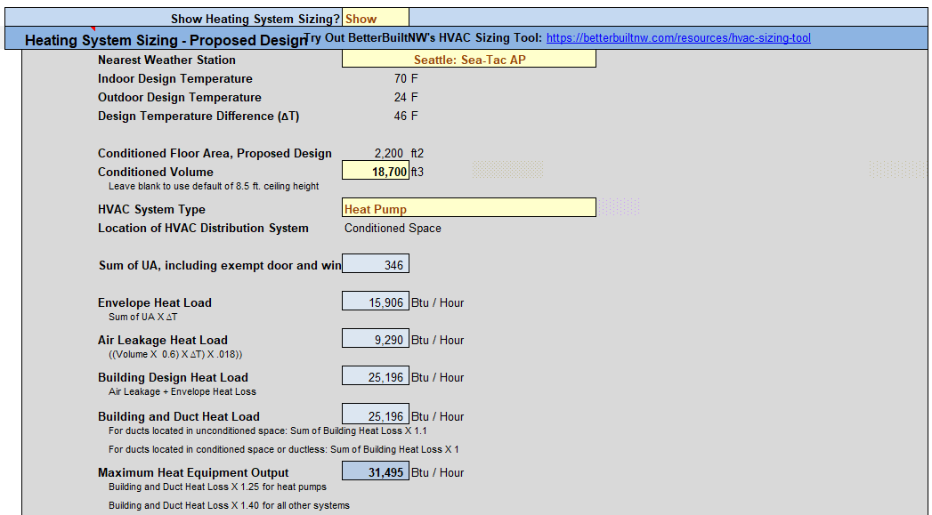
Heating System Sizing Worksheet 1
Only three additional inputs are required after entering other details
  Nearest weather station
  System type – Heat pump or not
  Location of ducts – unducted, conditioned space, unconditioned space
Location of ducts is selected in “HVAC Thermal Distribution System”

Slide 36
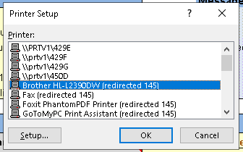
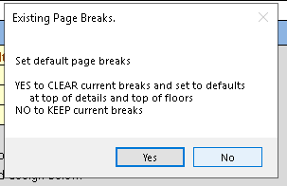
Printing Your Results
At the top of the Group R tab are some printing buttons
Select Printer button
  Select from a drop down of available printers
  Asks if you want to accept the default page breaks
Adjust Page Breaks button
  You can change where page breaks occur If you have a long list of windows or if you aren’t printing out the Tables 406
  Add row numbers of new breaks one by one
Print button
  Shows preview of your print first and gives you option of printing or canceling.

Slide 37
Two Examples
Now let’s go through two spreadsheet examples
  Medium-Sized Single Family Residence
    Table 406 UA Trade Off
  Small Addition to Single Family Residence (less than 500 sq. ft.)
    Example of User-Defined Baseline
    Existing home has 1,107 sq. ft. of ceiling area in vented attic where insulation could easily be added as a trade-off to make it easier to achieve required energy credits

Slide 38
4:00-4:30
Q&A, Open Discussion, Wrap Up and Next Steps

Slide 39


Send questions and comments to:
Carolyn Roos
360-956-2042
Join our update list: energycode@energy.wsu.edu

