Slide 1
Benefits of field sorting for your bottom line Dollars and cent benefits of getting only marketable fruit in the bin
R. Karina Gallardo
School of Economics Sciences
Puyallup REC
NCW Apple Day
January 20, 2026

Slide 2
Selective Picking: How Costs and Revenues Adjust
Slide 2
🍎 Harvest Selectivity
% defective fruit left on the tree
Selective picking reallocates costs from packinghouse to orchard labor while improving marketable packouts.
⏱️ Picking Intensity & Speed
Slower picking · More labor hours: ↑ Harvest labor cost
🌳 Fewer Defective Apples Delivered
↓ Bins sent to packinghouse · ↑ Packout rate
🏭 Packinghouse Outcomes
Receiving cost ↓ · Packing cost per box ↑ → Packing cost per acre
📦 Marketable Boxes per Acre
× FOB price per 40-lb box. → Total revenue
Notes:
This slide shows the economic logic behind selective picking.
Increasing selectivity slows harvest which increases labor costs.
But it reduces defective fruit delivered to the packinghouse, improves packout: increasing marketable boxes.
Net revenue reflects the trade-off between higher labor costs and improved fruit quality.

Slide 3
Slide 3
Harvest Strategy Scenarios
Cultivar | Harvest strategy | Share of defects left | Harvest intensity | Economic logic
Gala | Fast pick – low packout | 0% | One pass, fast | Lowest labor, weak packout
 | Fast pick – high packout | 0% | One pass, fast | Low labor, high volume
 | Slow pick (20% left) | 20% | One pass, selective | Higher labor, quality gains
 | Two-pass selective (70%+30%) | 15% | Two passes | Quality targeting, high cost
Honeycrisp | Fast pick – no defects left | 0% | One pass, fast | High labor productivity, quality risk
 | Fast pick – 15% left | 15% | One pass, moderate | Balance volume and quality
 | Slow pick – 30% left | 30% | One pass, selective | Protects packout, slower labor
 | Slow pick – 50% left | 50% | One pass, highly selective | Maximizes quality, large volume loss
 | Two-pass selective (70%+30%) | 30% | Two passes | Premium targeting, highest labor
Notes:
This table is not about right or wrong practices. It shows how different harvest intensities translate into different economic outcomes, and why that translation depends on the cultivar.
Gala
Gala tolerates fast picking better because packout penalties are smaller.
Moving from fast pick to slow or two-pass increases costs, and quality gains must be large to justify that shift.
Speed can still pay in Gala if packout response is modest.
Honeycrisp
Honeycrisp is fundamentally different.
Leaving some defects in the tree protects packout and revenues.
Extremely selective or two-pass strategies target premiums but quickly escalate labor costs.
Moderate selectivity dominates extremes; quality protection matters more than speed.
Leaving fruit behind is not waste; it’s a way to avoid paying packing and downgrade costs on fruit that will never pay for itself
Think of harvest strategy as a dial, not a switch. The right setting depends on cultivar, labor costs, and how strongly packout responds to selectivity

Slide 4
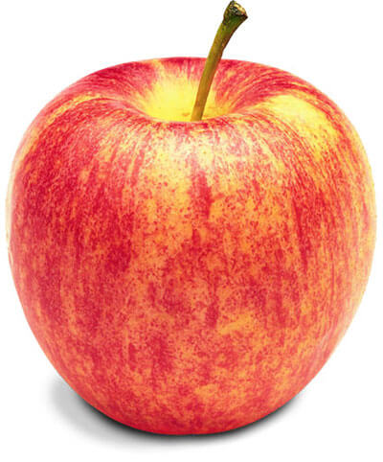
Gala apple scenarios

Slide 5
Slide 5
Gala: Picking Labor Assumptions and Costs
Harvest strategy | Pass | Hourly wage equivalent ($/hr) | Picking rate (hr/bin) | Piece rate ($/bin) | Share of crop harvested (%) | Bin weight (lb) | Picking hr/acre | Picking cost ($/acre)
Fast pick – low packout | Single | 22.63 | 1.00 | 22.63 | 100 | 925 | 70.0 | 1,584
Fast pick – high packout | Single | 22.63 | 1.00 | 22.63 | 100 | 925 | 70.0 | 1,584
Slow pick (20% left) | Single | 21.63 | 1.50 | 32.45 | 80 | 925 | 105.0 | 2,271
Two-pass selective (total) | — | — | — | — | 85 | 925 | 80.5 | 1,741
Two-pass selective (70%+30%) | Pass 1 | 21.63 | 1.00 | 21.63 | 55 | 925 | 49.0 | 1,060
Two-pass selective (70%+30%) | Pass 2 | 21.63 | 1.50 | 32.45 | 30 | 925 | 31.5 | 681
Notes:
This table shows what growers are really paying for at harvest: speed versus selectivity, and how those choices translate into picking hours and dollars per acre.
1. Anchor attention on the last two columns: Tell growers to ignore the middle columns at first and focus on: Picking hr/acre & Picking cost ($/acre) Explain: “Everything to the left explains why these two numbers change.”
2. Compare strategies: Fast pick (low & high packout) One pass, full crop harvested - Lowest hours per acre (70) - Lowest picking cost ($1,584/acre) - Fast and cheap, but no quality screening
Slow pick (20% left): One pass, selective - More hours (105 hr/acre) - Higher cost ($2,271/acre) - Paying extra labor to protect quality
Two-pass selective (total): Two targeted passes instead of one slow pass - Fewer total hours than slow picking (80.5 hr/acre) - Lower total picking cost than slow pick ($1,741 vs. $2,271) - Labor is concentrated where value is highest
3. Logic of splitting passes: Point to Pass 1 and Pass 2: “The two-pass strategy doesn’t reduce work—it reallocates it.” - Pass 1 captures high-value fruit efficiently- Pass 2 cleans up remaining fruit at a higher cost but lower volume - Total cost stays moderate because not all fruit is picked slowly
Selective harvesting raises labor costs, but splitting selectivity into two targeted passes can achieve quality gains at lower total picking cost than slow one-pass harvesting

Slide 6
Gala: Support Labor Checker – Hauling
Slide 6
Harvest strategy | Pass | Checker cost ($/bin) | Hauling cost ($/bin) | Checker hr/bin | Hauling hr/bin | Support hr/acre | Support cost ($/acre)
Fast pick – low packout | Single | 11.00 | 11.00 | 0.49 | 0.49 | 68.05 | 1,540
Fast pick – high packout | Single | 11.00 | 11.00 | 0.49 | 0.49 | 68.05 | 1,540
Slow pick (20% left) | Single | 10.00 | 10.00 | 0.46 | 0.46 | 64.72 | 1,400
Two-pass selective (total) | — | 20.00 | 20.00 | 0.92 | 0.92 | 129.45 | 2,800
Notes:
This table isolates the hidden labor at harvest—checkers and hauling—that shows up whether you pick fast or selective
1. Start with the last column - Support cost ($/acre): - Fast pick strategies: $1,540/acre - Slow pick (20% left): $1,400/acre - Two-pass selective: $2,800/acre
2. Fast picking still requires nearly 70 support hours per acre - Checker + hauling costs are fixed per bin, not per quality outcome - Speed does not reduce support labor proportionally
3. Support costs roughly double because fruit is handled twice - Checker and hauling time increases from ~65 to 129 hr/acre - The cost increase is mechanical, not inefficiency.
Support labor costs are largely fixed per bin and per pass, so two-pass harvesting doubles checker and hauling costs even if picking labor is optimized.

Slide 7
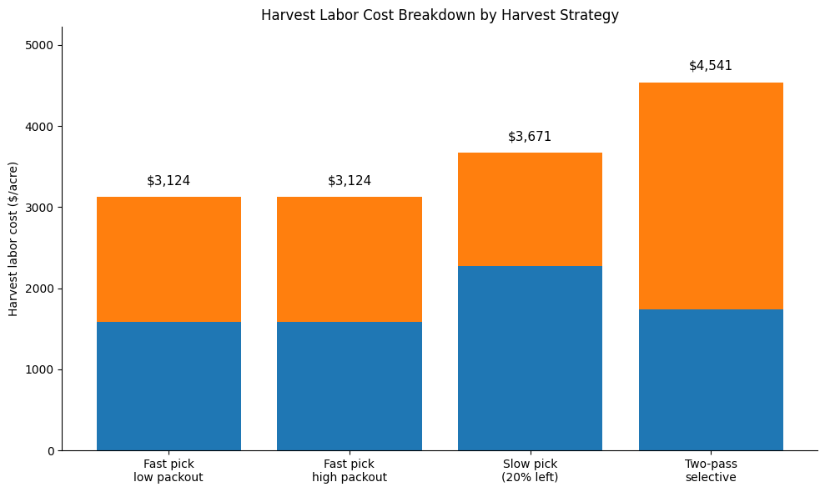
Slide 7
Gala: Total Harvest Labor Cost Summary
Harvest strategy | Picking cost ($/acre) | Support labor ($/acre) | Total harvest labor ($/acre)
Fast pick – low packout | 1,584 | 1,540 | 3,124
Fast pick – high packout | 1,584 | 1,540 | 3,124
Slow pick (20% left) | 2,271 | 1,400 | 3,671
Two-pass selective | 1,741 | 2,800 | 4,541
Notes:
This slide puts all harvest labor on the same footing—picking plus support—so we can see the true cost per acre of each strategy.
2. Fast pick (low & high packout): $3,124/acre - Slow pick (20% left): $3,671/acre - Two-pass selective: $4,541/acre: As harvest becomes more selective, total labor costs rise—not because pickers are inefficient, but because fruit is handled more carefully or more than once.
3. Two-pass selective has lower picking cost than slow pick - But support labor nearly doubles, driving the highest total cost.
Selective harvesting increases total labor costs because support labor scales with fruit handling, not picking speed

Slide 8
Gala: Packout and Packing Cost
Slide 8
Harvest strategy | Defects left in tree (%) | Bins to packing house (bin/acre) | Packout (%) | Fresh boxes/acre
Fast pick – low packout | 0 | 70.0 | 50% | 809
Fast pick – high packout | 0 | 70.0 | 90% | 1,457
Slow pick (20% left) | 20 | 56.0 | 90% | 1,166
Two-pass selective (70%+30%) | 15 | 59.5 | 80% | 1,101
Harvest strategy | Receiving cost ($/acre) | Packing fee ($/acre) | Total packing cost ($/acre)
Fast pick – low packout | 7,700 | 6,475 | 14,175
Fast pick – high packout | 7,700 | 11,655 | 19,355
Slow pick (20% left) | 6,160 | 9,324 | 15,484
Two-pass selective (70%+30%) | 6,545 | 8,806 | 15,351
Notes:
This slide shows how harvest selectivity changes what goes to the packinghouse and, ultimately, what you pay per acre in packing costs.
1. Defects left in the tree reduce the number of bins shipped - Fewer bins lower receiving costs, but - Higher packout percentages raise packing fees per acre - You’re trading bins for boxes.
2. Fast pick–high packout is most expensive because many bins and many boxes are packed - Slow pick and two-pass reduce bins, but packing fees remain substantial - Packing costs do not fall proportionally with selectivity. Packing costs respond more to boxes than to bins.
3. Harvest strategy determines the cost structure you face downstream
4. Leaving defects in the orchard reduces bins shipped, but higher packout keeps packing costs high, so selectivity does not guarantee lower packing expenses

Slide 9
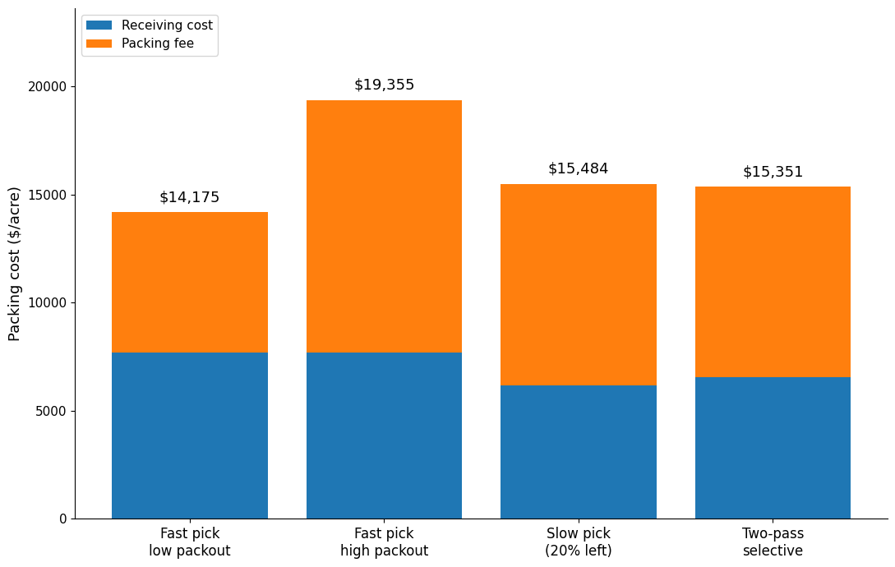
Slide 9
Gala: Packing Cost Breakdown by Harvest Strategy
Harvest strategy | Fresh boxes/acre
Fast pick – low packout | 809
Fast pick – high packout | 1,457
Slow pick (20% left) | 1,166
Two-pass selective | 1,101
Notes:
Let me reiterate what I presented in the previous slide: Packing costs rise with the number of fresh boxes, not just bins delivered. Fast picking with high packout produces the most boxes and the highest packing cost per acre, while more selective strategies ship fewer bins but still face substantial packing fees. The key point is that harvest decisions directly shape packing costs through box volume.

Slide 10
Gala: Summary of Costs and Returns by Harvest Strategy
Slide 10
Item | Fast picking – Low packout | Fast picking – High packout | Slow picking – Leave 20% defective | Two-pass selective harvest
Harvest costs ($/acre) | 3,124 | 3,124 | 3,671 | 4,541
Harvest cost per bin ($/bin) | 89 | 50 | 73 | 95
Packing costs ($/acre) | 14,175 | 19,355 | 15,484 | 15,351
Other variable costs ($/acre) | 6,726 | 6,726 | 6,726 | 6,726
Total costs ($/acre) | 24,025 | 29,205 | 25,881 | 26,618
Fresh fruit sellable (box/acre) | 809 | 1,457 | 1,166 | 1,101
FOB price ($/40-lb box) | 25 | 25 | 25 | 25
Total revenues ($/acre) | 20,234 | 36,422 | 29,138 | 27,519
Net revenue ($/acre) | -3,791 | 7,217 | 3,256 | 901
Notes:
This table summarizes, per acre, how each harvest strategy translates into costs, marketable boxes, revenues, and ultimately net returns for Gala.
1- Harvest and packing costs: Across strategies, harvest labor costs vary, but they are not the dominant driver. What changes much more is packing cost, which reflects how many bins and boxes actually go through the packing house. - Harvest cost per bin ranges from $50 to $95 - Packing costs range from $14,175 to $19,355 per acre = This already hints that packout matters more than picking speed.
2- Now look at fresh fruit sellable per acre. That’s where strategies truly separate. - Low packout fast pick: 809 boxes - High packout fast pick: 1,457 boxes - Selective strategies: intermediate These differences in boxes dominate differences in labor cost.”
3- Revenues and net returns: At a constant FOB price, revenues simply scale with boxes. That’s why net revenue swings from –$3,791 to +$7,217 per acre. The ranking of profitability follows boxes per acre, not harvest cost per bin.
Across harvest strategies, differences in packout and marketable volume dominate differences in harvest labor costs.

Slide 11
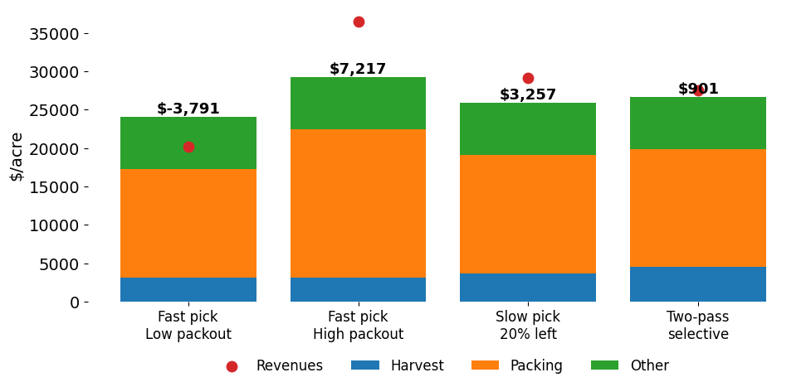
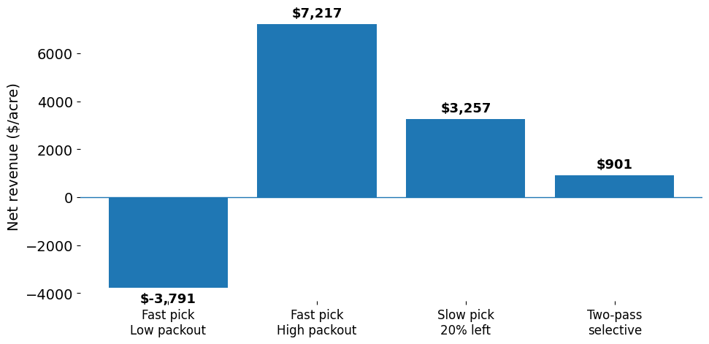
Gala: Summary of Costs and Returns by Harvest Strategy
Slide 11
Profitability is determined by packout and marketable volume, not by minimizing harvest costs per bin.
Notes:
This table has a lot of numbers, so the next figure simply visualizes this same story—where the money goes and what’s left at the end.
The graph makes it clear that strategies with higher packing costs are often more profitable, because those costs are tied to more sellable fruit.
Strategies that protect packout and marketable volume outperform low-cost harvest strategies, even when labor costs are higher.
The economic question is not how fast/cheap can I pick, but how my harvest decisions affect packout and boxes sold per acre

Slide 12
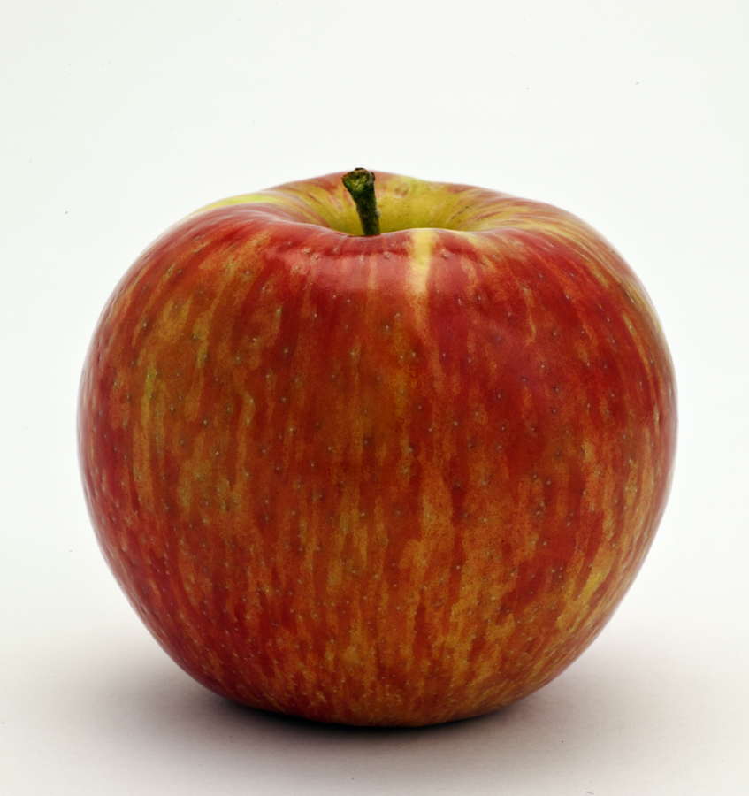
Honeycrisp apple scenarios

Slide 13
Slide 13
Honeycrisp: Picking Labor Assumptions and Costs
Harvest strategy | Pass | Hourly wage equivalent ($/hr) | Picking rate (hr/bin) | Piece rate ($/bin) | Share of crop harvested (%) | Bin weight (lb) | Picking hr/acre | Picking cost ($/acre)
Fast pick – low packout | Single | 25.63 | 1.50 | 38.45 | 100 | 825 | 105.0 | 2,691
Fast pick – high packout | Single | 25.63 | 1.75 | 44.85 | 85 | 825 | 122.5 | 3,140
Slow pick – 30% left | Single | 21.63 | 2.50 | 54.08 | 70 | 825 | 175.0 | 3,785
Slow pick – 50% left | Single | 21.63 | 3.00 | 64.89 | 50 | 825 | 210.0 | 4,542
Two-pass selective (total) | — | — | — | — | 70 | 825 | 138.3 | 3,543
Two-pass selective (70%+30%) | Pass 1 | 25.63 | 1.75 | 44.85 | 40 | 825 | 85.8 | 2,198
Two-pass selective (70%+30%) | Pass 2 | 25.63 | 2.50 | 64.08 | 30 | 825 | 52.5 | 1,346
Notes:
I won’t walk through the mechanics again — this table uses the same labor accounting we just saw for Gala
Rightmost column (Picking cost $/acre): Fast pick → lowest cost - Slower, more selective → rapid cost escalation - Two-pass → sits in the middle, not the highest> What matters here is the pattern: as Honeycrisp picking becomes more selective, hours per acre rise quickly, and picking costs increase sharply. Compared to Gala, Honeycrisp is far more sensitive to picking intensity — small changes in selectivity translate into large labor cost differences.
For Honeycrisp, labor costs escalate quickly with selectivity, making harvest strategy a much higher-stakes economic decision than for Gala. Unlike Gala, Honeycrisp penalizes slow and selective picking much more heavily on the labor side.

Slide 14
Honeycrisp: Support Labor Checker – Hauling
Slide 14
Harvest strategy | Pass | Checker cost ($/bin) | Hauling cost ($/bin) | Checker hr/bin | Hauling hr/bin | Support hr/acre | Support cost ($/acre)
Fast pick – low packout | Single | 11.00 | 11.00 | 0.43 | 0.43 | 60.09 | 1,540
Fast pick – high packout | Single | 10.00 | 10.00 | 0.39 | 0.39 | 54.62 | 1,400
Slow pick – 30% left | Single | 9.00 | 9.00 | 0.42 | 0.42 | 58.25 | 1,260
Slow pick – 50% left | Single | 9.00 | 9.00 | 0.42 | 0.42 | 58.25 | 1,260
Two-pass selective (total) | — | 20.00 | 20.00 | 0.78 | 0.78 | 109.25 | 2,800
Two-pass selective (70%+30%) | Pass 1 | 10.00 | 10.00 | 0.39 | 0.39 | 54.62 | 1,400
Two-pass selective (70%+30%) | Pass 2 | 10.00 | 10.00 | 0.39 | 0.39 | 54.62 | 1,400
Notes:
1. Just like the previous slide focused on picking labor, this one completes the picture by showing support labor — checkers and hauling.
2. Kast column only (Support cost $/acre): Single-pass strategies: roughly $1,260–$1,540 per acre - Two-pass selective: jumps to $2,800 per acre - The per-bin rates look similar — it’s the hours that double: What drives differences here is not the per-bin rates — those are very similar — but the number of hours per acre, especially under two-pass harvest.
3. So when we add picking and support labor together, two-pass strategies get hit twice — more picker hours and more support hours.
For Honeycrisp, support labor costs are relatively stable under single-pass harvest, but nearly double under two-pass strategies due to repeated handling.

Slide 15
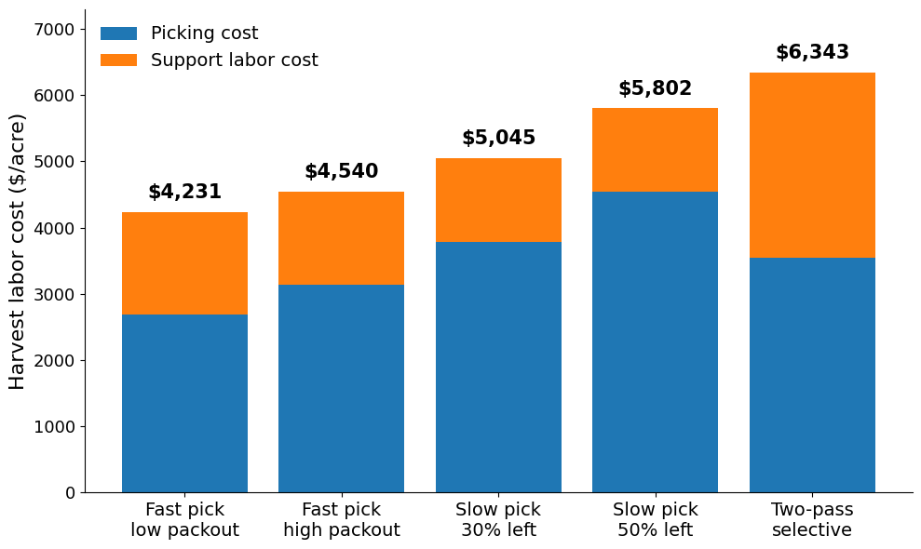
Slide 15
Honeycrisp: Total Harvest Labor Cost Summary
Harvest strategy | Picking cost ($/acre) | Support labor cost ($/acre) | Total harvest labor cost ($/acre)
Fast pick – low packout | 2,691 | 1,540 | 4,231
Fast pick – high packout | 3,140 | 1,400 | 4,540
Slow pick – 30% left | 3,785 | 1,260 | 5,045
Slow pick – 50% left | 4,542 | 1,260 | 5,802
Two-pass selective (70%+30%) | 3,543 | 2,800 | 6,343
Notes:
1. We just saw how picking labor and support labor behave separately for Honeycrisp — this slide simply adds them together: Once we combine both components, total harvest labor rises steadily as harvest becomes more selective.
2. Then call out orders of magnitude, not every number: Fast pick: about $4,200–$4,500/acre - Slow pick (30–50% left): $5,000–$5,800/acre - Two-pass: over $6,300/acre. The big jump under two-pass harvest is structural — fruit is handled twice, so both picking and support labor scale up.
3. The key question is whether higher packout and prices can offset this higher harvest cost — and that’s what we look at next
4. For Honeycrisp, total harvest labor costs increase sharply with selectivity, especially under two-pass harvest, due to repeated handling rather than higher wage rates.

Slide 16
Honeycrisp: Packout and Packing Cost
Slide 16
Harvest strategy | Defects left in tree (%) | Bins to packing house (bin/acre) | Packout (%) | Fresh boxes/acre
Fast pick – low packout | 0 | 70.0 | 40% | 577.5
Fast pick – leave 15% defective | 15 | 59.5 | 60% | 736.3
Slow pick – leave 30% defective | 30 | 49.0 | 70% | 707.4
Slow pick – leave 50% defective | 50 | 35.0 | 80% | 577.5
Two-pass selective (70%+30%) | 30 | 49.0 | 70% | 707.4
Harvest strategy | Receiving cost ($/acre) | Packing fee ($/acre) | Total packing cost ($/acre)
Fast pick – low packout | 7,700.00 | 4,620.00 | 12,320.00
Fast pick – leave 15% defective | 6,545.00 | 5,890.50 | 12,435.50
Slow pick – leave 30% defective | 5,390.00 | 5,659.50 | 11,049.50
Slow pick – leave 50% defective | 3,850.00 | 4,620.00 | 8,470.00
Two-pass selective (70%+30%) | 5,390.00 | 5,659.50 | 11,049.50
Notes:
This slide ties harvest selectivity directly to what happens at the packinghouse. As more defects are left in the orchard, fewer bins are delivered, packout rates rise, and receiving costs fall. However, fresh boxes per acre do not increase monotonically—very aggressive selectivity eventually reduces total marketable volume. The two-pass strategy lands in the middle: it improves packout but still incurs substantial handling costs. So the economic trade-off is not packout alone, but how harvest decisions reshape both volume and packing costs.
For Honeycrisp, higher packout lowers packing costs per acre only up to the point where lost volume begins to dominate

Slide 17
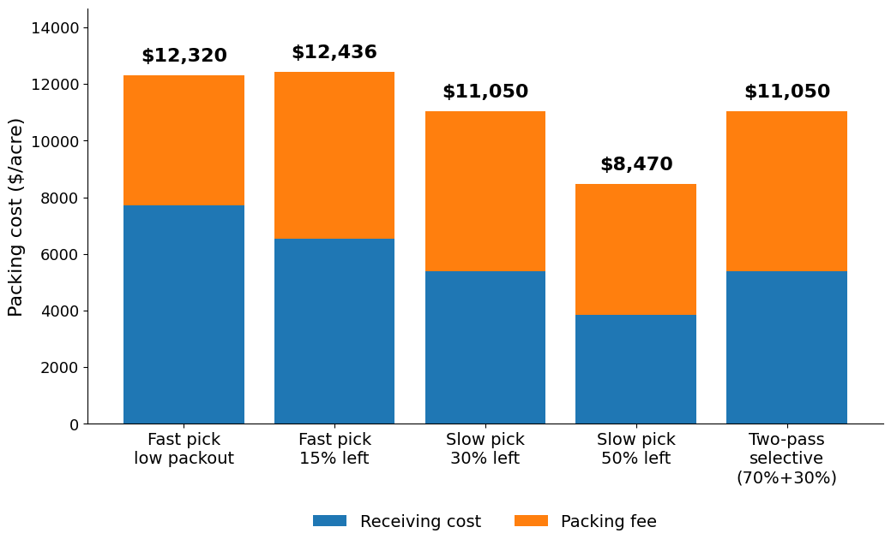
Slide 17
Honeycrisp: Packing Cost Breakdown by Harvest Strategy
Harvest strategy | Fresh boxes/acre
Fast pick – low packout | 577.50
Fast pick – leave 15% defective | 736.31
Slow pick – leave 30% defective | 707.44
Slow pick – leave 50% defective | 577.50
Two-pass selective (70% + 30%) | 707.44
Notes:
Building on the packout results, this figure shows how those decisions translate into packing costs per acre. As selectivity increases, fewer bins are delivered, so receiving costs fall, which you see in the blue bars. Packing fees, however, remain substantial because they scale with marketable volume, not just bins. The lowest total packing cost occurs at very high selectivity, but that also coincides with lower fresh boxes per acre. The two-pass strategy sits between these extremes, reducing receiving costs without fully sacrificing volume. For Honeycrisp, packing cost savings peak before volume losses offset the gains.

Slide 18
Slide 18
Honeycrisp: Summary of Costs and Returns by Harvest Strategy
Item | Fast pick – low packout | Fast pick – high packout | Slow pick – 30% left | Slow pick – 50% left | Two-pass selective (70%+30%)
Harvest costs ($/acre) | 4,231 | 4,540 | 5,045 | 5,802 | 6,343
Harvest cost per bin ($/bin) | 151 | 127 | 147 | 207 | 185
Packing costs ($/acre) | 12,320 | 12,436 | 11,050 | 8,470 | 11,050
Other variable costs ($/acre) | 7,026 | 7,026 | 7,026 | 7,026 | 7,026
Total costs ($/acre) | 23,577 | 24,001 | 23,121 | 21,299 | 24,419
Fresh fruit sellable (box/acre) | 577.5 | 736.3 | 707.4 | 577.5 | 707.4
FOB price ($/40-lb box) | 30 | 45 | 45 | 45 | 45
Total revenues ($/acre) | 17,325 | 33,134 | 31,835 | 25,988 | 31,835
Net revenue ($/acre) | -6,252 | 9,133 | 8,714 | 4,689 | 7,416
Notes:
This table pulls all the Honeycrisp pieces together.: Even though more selective strategies raise harvest cost per bin, total costs per acre actually fall as packing costs drop and packout improves. Revenues are driven by both price and sellable volume, which is why fast picking with high packout delivers the highest net return here. Extremely aggressive selectivity lowers costs, but it also reduces marketable volume enough to erode profits. The key result is that Honeycrisp profitability is maximized by balancing selectivity and volume, not by minimizing harvest costs alone.
For Honeycrisp, the most profitable strategy balances selectivity with marketable volume rather than chasing the lowest harvest cost.

Slide 19
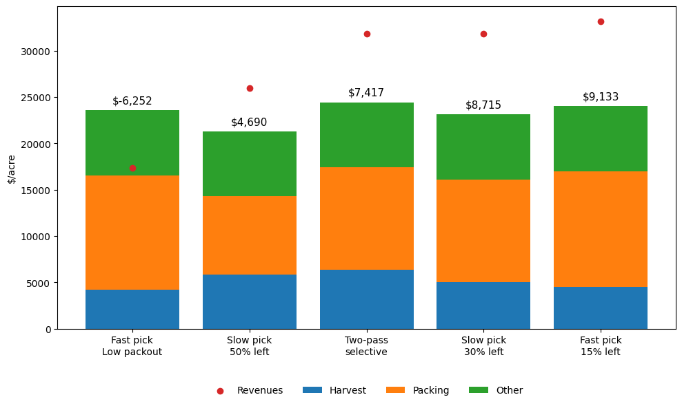
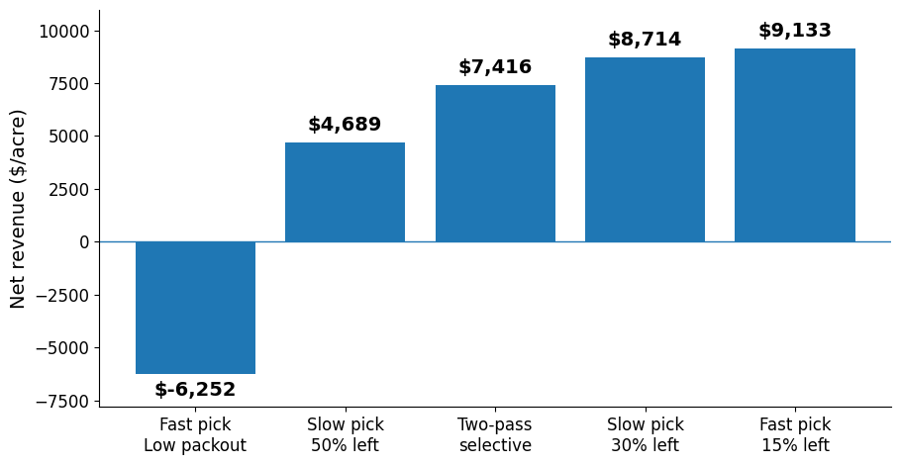
Slide 19
Honeycrisp: Summary of Costs and Returns by Harvest Strategy
Maximizing net returns depends less on minimizing harvest labor costs and more on optimizing fruit allocation to the packing house to enhance packout and revenues
Notes:
The clear message here is that Honeycrisp profitability is not driven by the lowest harvest labor cost. What matters most is how much fruit you send to the packing house and how well it packs out. Strategies that balance selectivity with volume generate the highest net returns, while chasing low labor costs alone leaves money on the table.
For Honeycrisp, packout and marketable volume matter more than minimizing harvest labor costs

Slide 20
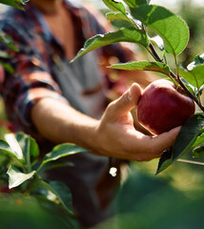
Slide 20
Concluding thoughts
Trade off between higher per box packing costs (reflecting more boxes per bin to be sold) with market prices.
Protecting packout and sellable volume increases profitability – especially in Honeycrisp.
Harvest decisions should prioritize boxes sold per acre, not picking speed or cost.
Source: https://stock.adobe.com/search?k=apple+harvest

Slide 21
Thank you - Questions? Interested on tree fruit economics? WSU SES Tree fruit economics https://ses.wsu.edu/extension/tree_fruit_economics/ R. Karina Gallardo https://ses.wsu.edu/faculty/wsu-profile/karina_gallardo/ karina_gallardo@wsu.edu

